Slide 1
Summary of the experiments

Slide 2
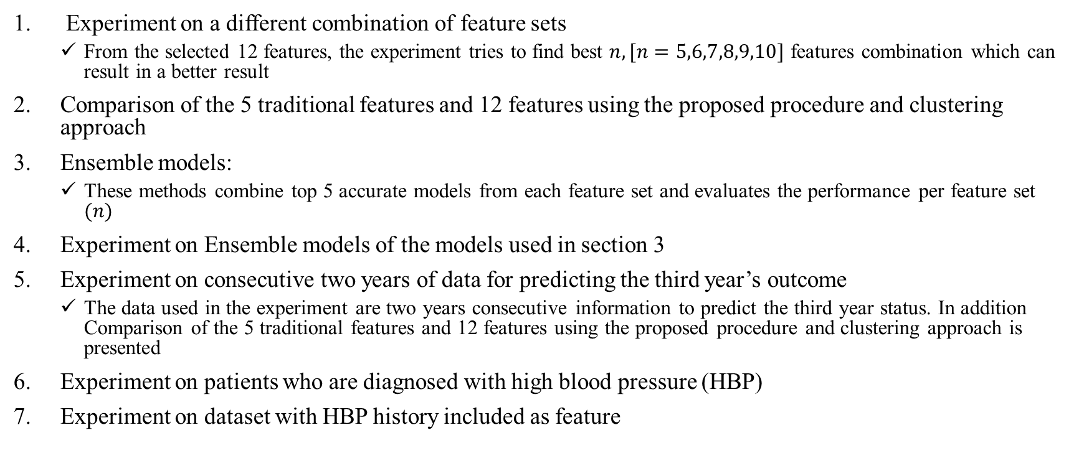
Content
Experiment on a different combination of feature sets
From the selected 12 features, the experiment tries to find best $n, [n=5,6,7,8,9,10]$ features combination which can result in a better result
Comparison of the 5 traditional features and 12 features using the proposed procedure and clustering approach
Ensemble models:
These methods combine top 5 accurate models from each feature set and evaluates the performance per feature set $(n)$
Experiment on Ensemble models of the models used in section 3
Experiment on consecutive two years of data for predicting the third year’s outcome
The data used in the experiment are two years consecutive information to predict the third year status. In addition Comparison of the 5 traditional features and 12 features using the proposed procedure and clustering approach is presented
Experiment on patients who are diagnosed with high blood pressure (HBP)
Experiment on dataset with HBP history included as feature

Slide 3
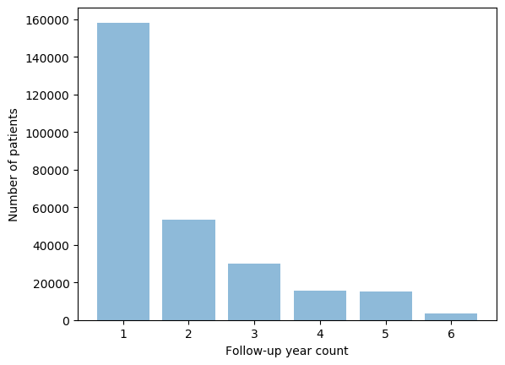
Dataset
This study considers only patients with
at least 2 years of continuous annual medical check-up during the follow-up period
not previously diagnosed with Diabetes, hyperlipidemia, or hypertension
No missing features Instances
The total number of instances after the preprocessing is 169,024
Number of patients: 80,692
Male count: 48,912
Female count: 31,780
The mean age: 41.17 ± 9.95
Region of interest
 | Training set | Testing set
Diabetes | 17,131 | 200
Prediabetes | 17,131 | 200
Normal | 17,131 | 200

Slide 4

1. Experiment on a different combination of feature sets
The experiment generates all combination of $n$ features from the total 12 features $[C(12,n)]$, train and test the models, and select the top 10 accurate models from each subgroup
Experimental results of different $n$ feature set combination using XGBoost algorithm (5,6,7,8,9, and 10 features ) presented below

Slide 5

1. Experiment on a different combination of feature sets
5 Features Combination
A total of 792 [$C(12,5)]$ models are generated, trained and tested
Top 10 models based on the accuracy metric is presented in the table below
 | Features | Accuracy
1 | FPG, HbA1c, Physical Activity, Family History, Sex | 0.753
2 | FPG, HbA1c, Smoking, Physical Activity, Sex | 0.746
3 | FPG, HbA1c, Drinking, Family History, Sex | 0.746
4 | FPG, HbA1c, Triglyceride, Physical Activity, Sex | 0.745
5 | FPG, HbA1c, Uric Acid, Physical Activity, Sex | 0.745
6 | FPG, HbA1c, Uric Acid, Smoking, Age | 0.745
7 | FPG, HbA1c, Drinking, Physical Activity, Family History | 0.743
8 | FPG, HbA1c, Family History, Sex, Age | 0.743
9 | FPG, HbA1c, Uric Acid, Sex, Age | 0.743
10 | FPG, HbA1c, Triglyceride, Uric Acid, Age | 0.741

Slide 6

1. Experiment on a different combination of feature sets
6 Features Combination
A total of 924 [$C(12,6)]$ models are generated, trained and tested
Top 10 models based on the accuracy metric is presented in the table below
 | Features | Accuracy
1 | FPG, HbA1c, Uric acid, Smoking, Physical Activity, Sex | 0.753
2 | FPG, HbA1c, Uric acid, Drinking, Physical Activity, Sex | 0.751
3 | FPG, HbA1c, Smoking, Family History, Sex, Age | 0.751
4 | FPG, HbA1c, BMI, Smoking, Physical Activity, Sex | 0.750
5 | FPG, HbA1c, Triglyceride, Uric acid, Physical Activity, Sex | 0.750
6 | FPG, HbA1c, Smoking, Physical Activity, Family History, Sex | 0.750
7 | FPG, HbA1c, BMI, Family History, Sex, Age | 0.748
8 | FPG, HbA1c, Uric acid, Drinking, Family History, Sex | 0.748
9 | FPG, HbA1c, smoking, Physical activity, Sex, Age | 0.748
10 | FPG, HbA1c, Triglyceride, smoking, Physical activity, Sex | 0.748

Slide 7

1. Experiment on a different combination of feature sets
7 Features Combination
A total of 792 [$C(12,5)]$ models are generated, trained and tested
Top 10 models based on the accuracy metric is presented in the table below
 | Features | Accuracy
1 | FPG, HbA1c, BMI, Uric acid, Smoking, Sex, Age | 0.750
2 | FPG, HbA1c, BMI, GTP gamma, Uric acid, Sex, Age | 0.750
3 | FPG, HbA1c, Triglyceride, BMI, GTP gamma, Sex, Age | 0.750
4 | FPG, HbA1c, Triglyceride, BMI, Uric acid, Sex, Age | 0.750
5 | FPG, HbA1c, BMI, Smoking, Physical Activity, Sex, Age | 0.748
6 | FPG, HbA1c, Smoking, Physical Activity, Family History, Sex, Age | 0.748
7 | FPG, HbA1c, Smoking, Drinking, Physical Activity, Family History, Sex | 0.748
8 | FPG, HbA1c, Triglyceride, BMI, Physical Activity, Sex, Age | 0.748
9 | FPG, HbA1c, Triglyceride, Smoking, Physical Activity, Sex, Age | 0.748
10 | FPG, HbA1c, BMI, Physical Activity, Family History, Sex, Age | 0.746

Slide 8

1. Experiment on a different combination of feature sets
8 Features Combination
A total of 495 [$C(12,8)]$ models are generated, trained and tested
Top 10 models based on the accuracy metric is presented in the table below
 | Features | Accuracy
1 | FPG, HbA1c, Triglyceride, BMI, Uric acid, smoking, Sex, Age | 0.753
2 | FPG, HbA1c, Triglyceride, BMI, GTP gamma, smoking, Sex, Age | 0.750
3 | FPG, HbA1c, Triglyceride, BMI, GTP gamma, Family history, Sex, Age | 0.748
4 | FPG, HbA1c, Triglyceride, BMI, Uric acid, Family history, Sex, Age | 0.748
5 | FPG, HbA1c, BMI, GTP gamma, Uric acid, smoking, Family history, Age | 0.748
6 | FPG, HbA1c, BMI, GTP gamma, smoking, Family history, Sex, Age | 0.748
7 | FPG, HbA1c, BMI, GTP gamma, Physical activity, Family history, Sex, Age | 0.748
8 | FPG, HbA1c, Triglyceride, smoking, Physical activity, Family history, Sex, Age | 0.746
9 | FPG, HbA1c, Triglyceride, BMI, Uric acid, Physical activity, Sex, Age | 0.746
10 | FPG, HbA1c, BMI, GTP gamma, Uric acid, smoking, Sex, Age | 0.746

Slide 9

1. Experiment on a different combination of feature sets
9 Features Combination
A total of 220 [$C(12,9)]$ models are generated, trained and tested
Top 10 models based on the accuracy metric is presented in the table below
 | Features | Accuracy
1 | FPG, HbA1c, Triglyceride, BMI, Uric acid, smoking, Physical activity, Sex, Age | 0.750
2 | FPG, HbA1c, Triglyceride, BMI, GTP gamma, smoking, Family history, Sex, Age | 0.748
3 | FPG, HbA1c, Triglyceride, BMI, GTP gamma, Uric acid, smoking, Family history, Age | 0.746
4 | FPG, HbA1c, BMI, GTP gamma, smoking, Drinking, Family history, Sex, Age | 0.746
5 | FPG, HbA1c, BMI, GTP gamma, Uric acid, Physical activity, Family history, Sex, Age | 0.745
6 | FPG, HbA1c, BMI, GTP gamma, Uric acid, smoking, Family history, Sex, Age | 0.745
7 | FPG, HbA1c, BMI, GTP gamma, Uric acid, smoking, Physical activity, Sex, Age | 0.745
8 | FPG, HbA1c, BMI, GTP gamma, smoking, Drinking, Physical activity, Sex, Age | 0.745
9 | FPG, HbA1c, BMI, GTP gamma, Uric acid, smoking, Drinking, Physical activity, Age | 0.745
10 | FPG, HbA1c, BMI, Uric acid, smoking, Physical activity, Family history, Sex, Age | 0.745

Slide 10

1. Experiment on a different combination of feature sets
10 Features Combination
A total of 66 [$C(12,10)]$ models are generated, trained and tested
Top 10 models based on the accuracy metric is presented in the table below
 | Features | Accuracy
1 | FPG, HbA1c, Triglyceride, BMI, GTP gamma, Uric acid, smoking, Family history, Sex, Age | 0.745
2 | FPG, HbA1c, BMI, GTP gamma, smoking, Drinking, Physical activity, Family history, Sex, Age | 0.745
3 | FPG, HbA1c, Triglyceride, BMI, GTP gamma, Uric acid, smoking, Drinking, Sex, Age | 0.743
4 | FPG, HbA1c, Triglyceride, BMI, GTP gamma, Uric acid, smoking, Physical activity, Sex, Age | 0.743
5 | FPG, HbA1c, Triglyceride, BMI, Uric acid, smoking, Physical activity, Family history, Sex, Age | 0.743
6 | FPG, HbA1c, BMI, GTP gamma, Uric acid, smoking, Physical activity, Family history, Sex, Age | 0.741
7 | FPG, HbA1c, BMI, GTP gamma, Uric acid, smoking, Drinking, Family history, Sex, Age | 0.741
8 | FPG, HbA1c, Triglyceride, BMI, GTP gamma, Uric acid, Physical activity, Family history, Sex, Age | 0.741
9 | FPG, HbA1c, Triglyceride, BMI, GTP gamma, Uric acid, smoking, Drinking, Family history, Age | 0.741
10 | FPG, HbA1c, Triglyceride, BMI, GTP gamma, smoking, Drinking, Family history, Sex, Age | 0.740

Slide 11
1. Experiment on a different combination of feature sets
Remarks
Increasing the number of features doesn’t necessarily imply prediction performance improvement
The maximum accuracy of the modes recorded is 0.753 on the test dataset. However, the maximum average value of the top 10 models is 0.749
The total number of models trained and tested in this experiment is 3,289. Based on the result using the test data, the most accurate results are around 74%, which implies the most achievable accuracy for the given dataset and the proposed ML flow. (N.B. The results are not cross-validated and tested only on the test set, because of the large size of the models. However, due to the variation of the models and features used on the experiment, we can generalize the results as the performance indicator )
Based on the experimental results, the traditional predictors [Fasting plasma glucose (FPG), HbA1c, BMI, age and gender] didn’t show the best results. However, other predictors presented on page 5 outperformed the traditional predictors

Slide 12
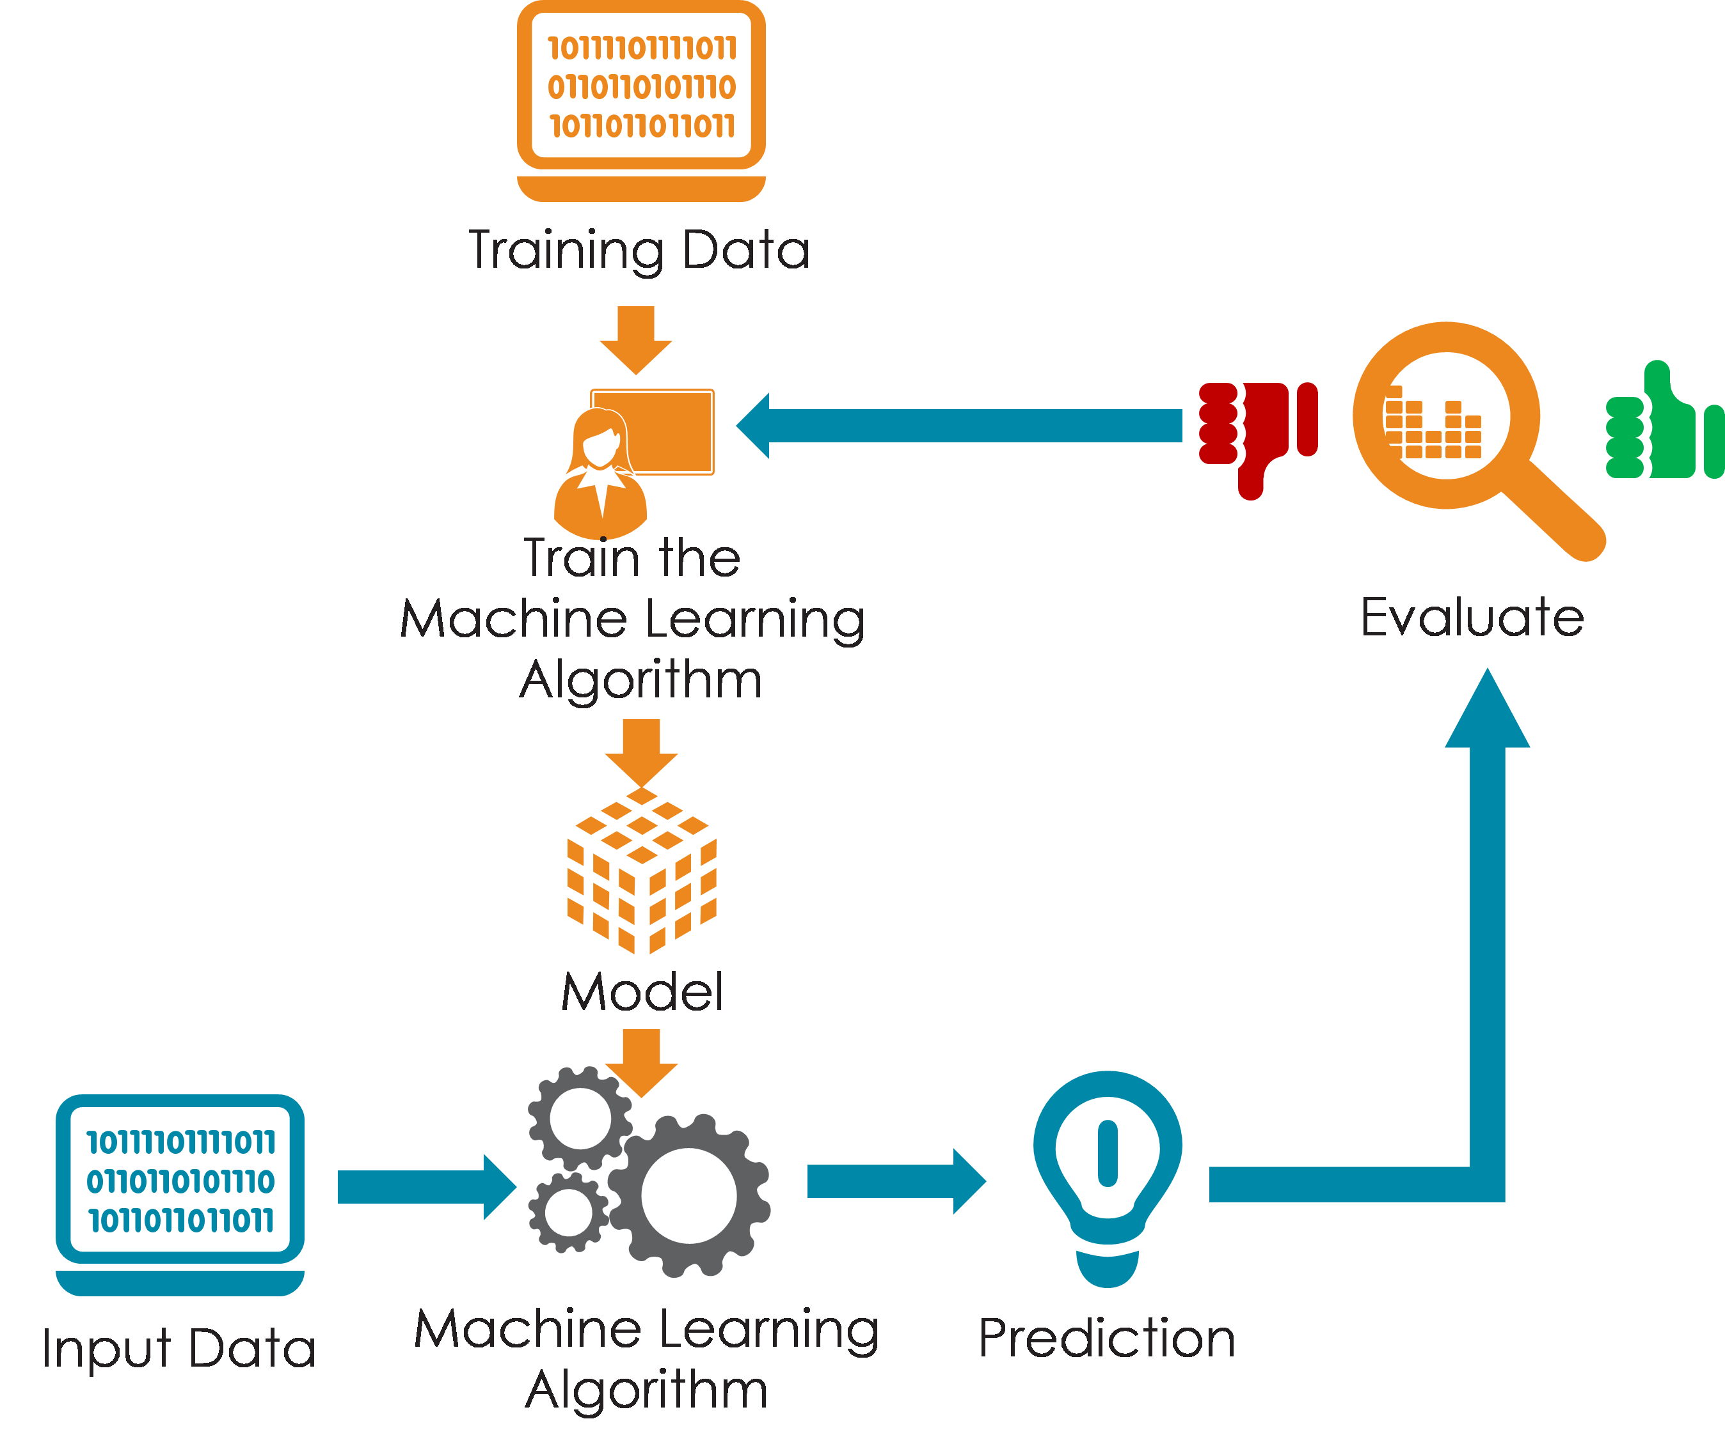
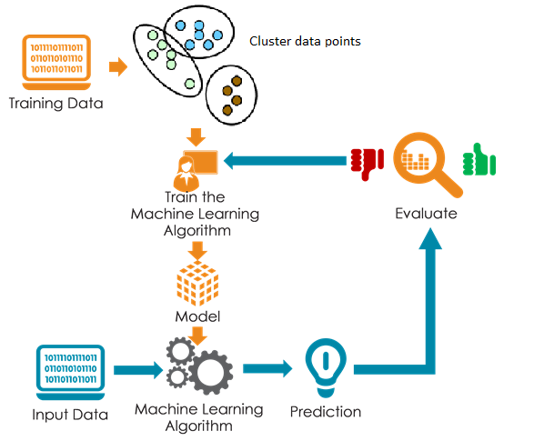
2. Comparison of ML flow with Clustering vs with out clustering approach
In these experiments, the K-means clustering algorithm used to cluster the data points and generate labels for each datum
The generated cluster label is used as a new feature and added to the feature set
a) ML flow
b) ML flow with clustering

Slide 13
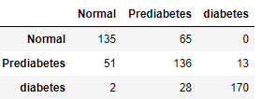
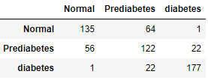
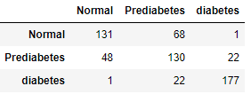
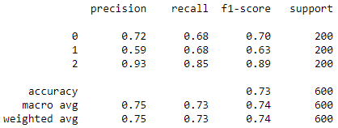
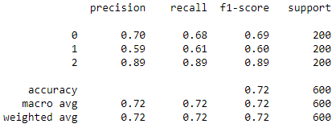
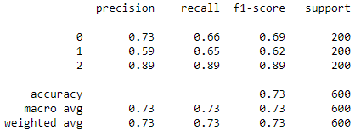
2. Comparison of ML flow with Clustering vs with out clustering approach
5 Features (Traditional features)
 | Training set | Testing set
Diabetes | 18,508 | 200
Prediabetes | 18,508 | 200
Normal | 18,508 | 200
RF
Accuracy = 0.735
CV accuracy = 0.74 (+/- 0.04)
XGBoost
Accuracy = 0.723
CV accuracy = 0.70 (+/- 0.04)
SVM
Accuracy = 0.73
CV accuracy = 0.71 (+/- 0.02)

Slide 14
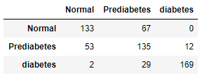
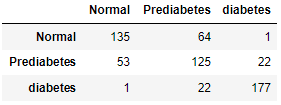
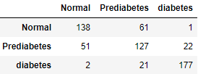
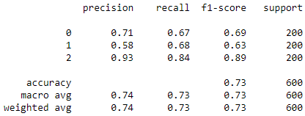
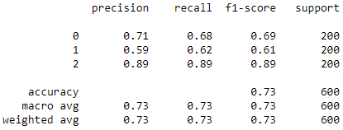
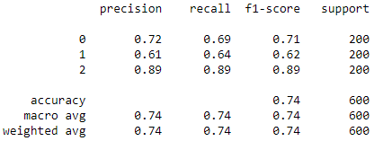
2. Comparison of ML flow with Clustering vs with out clustering approach
5 Features (Traditional features) with clustering
RF
Accuracy = 0.728
CV accuracy = 0.74 (+/- 0.04)
XGBoost
Accuracy = 0.728
CV accuracy = 0.70 (+/- 0.04)
SVM
Accuracy = 0.736
CV accuracy = 0.71 (+/- 0.03)

Slide 15
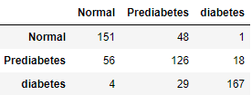
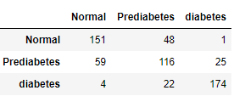
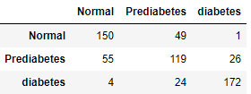
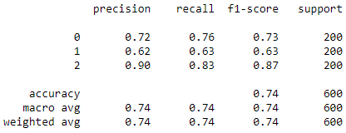
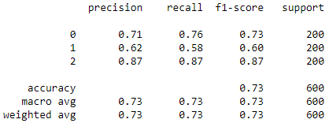
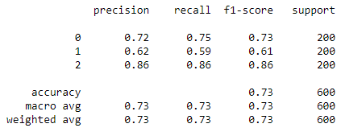
2. Comparison of ML flow with Clustering vs with out clustering approach
12 Features with out clustering
 | Training set | Testing set
Diabetes | 17,131 | 200
Prediabetes | 17,131 | 200
Normal | 17,131 | 200
RF
Accuracy = 0.74
CV accuracy = 0.75 (+/- 0.04)
XGBoost
Accuracy = 0.735
CV accuracy = 0.71 (+/- 0.04)
SVM
Accuracy = 0.735
CV accuracy = 0.72 (+/- 0.03)

Slide 16
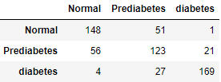
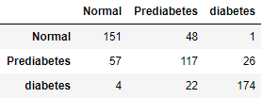
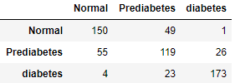
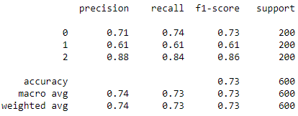
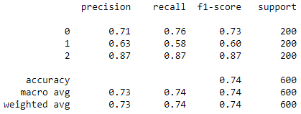
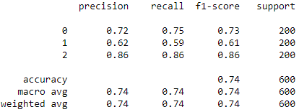
2. Comparison of ML flow with Clustering vs with out clustering approach
12 Features with clustering
RF
Accuracy = 0.733
CV accuracy = 0.75 (+/- 0.04)
XGBoost
Accuracy = 0.736
CV accuracy = 0.71 (+/- 0.04)
SVM
Accuracy = 0.736
CV accuracy = 0.72 (+/- 0.03)

Slide 17
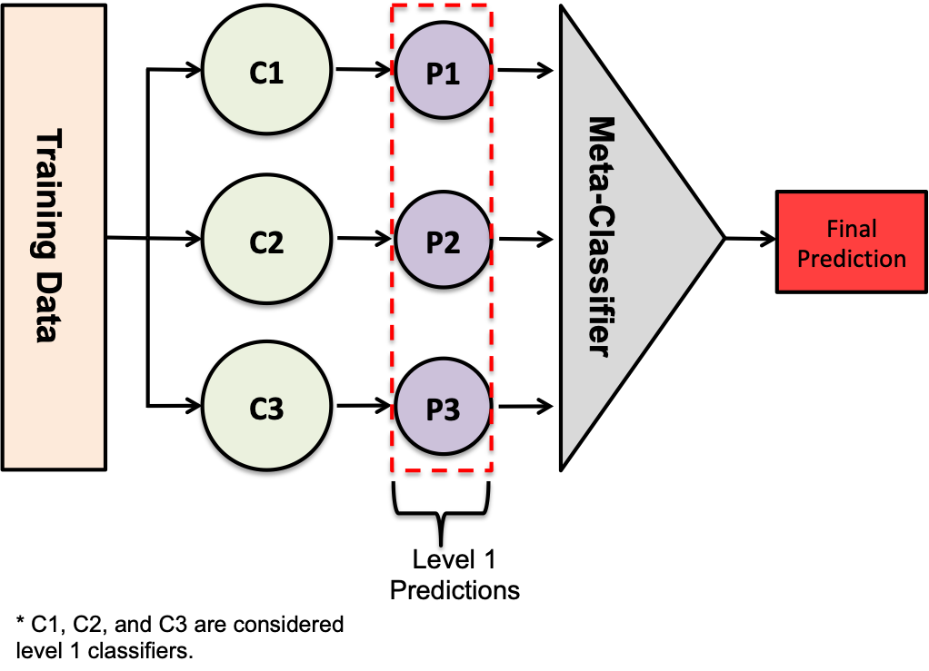
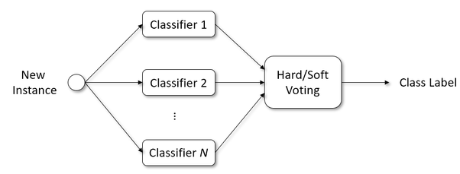
3. Ensemble Approach
Stacking classifier
In this sub section, top 5 more accurate models from each feature sets are selected and ensembled using
Stacking classifier
Soft voting classifier
Hard voting classifier
The algorithms used in this experiment are
RF
SVM
XGBoost
A total of 15 models are used for each ensemble technique
Voting classifer
 | Training set | Testing set
Diabetes | 17,131 | 200
Prediabetes | 17,131 | 200
Normal | 17,131 | 200

Slide 18
3. Ensemble Approach

Slide 19
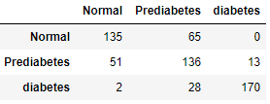
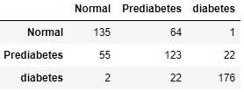
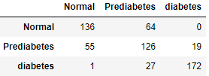
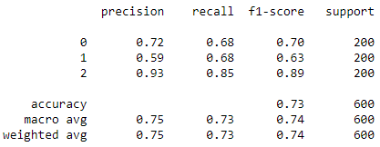
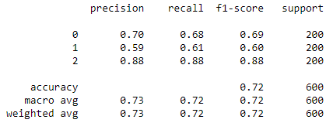
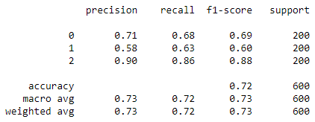
3. Ensemble Approach
5 Features Combination
 | Features
1 | FPG, HbA1c, Physical Activity, Family History, Sex
2 | FPG, HbA1c, Smoking, Physical Activity, Sex
3 | FPG, HbA1c, Drinking, Family History, Sex
4 | FPG, HbA1c, Triglyceride, Physical Activity, Sex
5 | FPG, HbA1c, Uric Acid, Physical Activity, Sex
Stacking Classifier
accuracy 0.735
Hard Voting Classifier
accuracy 0.723
Soft Voting Classifier
accuracy 0.723

Slide 20
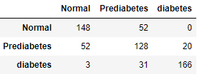
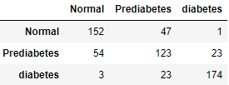
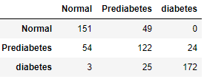
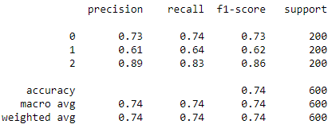
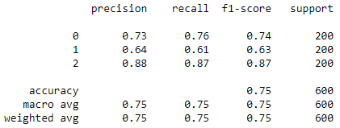
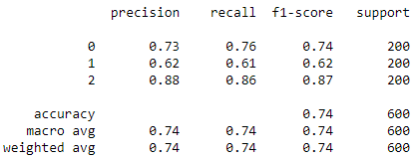
3. Ensemble Approach
6 Features Combination
 | Features
1 | FPG, HbA1c, Uric acid, Smoking, Physical Activity, Sex
2 | FPG, HbA1c, Uric acid, Drinking, Physical Activity, Sex
3 | FPG, HbA1c, Smoking, Family History, Sex, Age
4 | FPG, HbA1c, BMI, Smoking, Physical Activity, Sex
5 | FPG, HbA1c, Triglyceride, Uric acid, Physical Activity, Sex
Stacking Classifier
accuracy 0.736
Hard Voting Classifier
accuracy 0.748
Soft Voting Classifier
accuracy

Slide 21
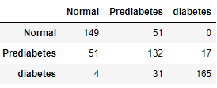





3. Ensemble Approach
7 Features Combination
 | Features
1 | FPG, HbA1c, Uric acid, Smoking, Physical Activity, Sex
2 | FPG, HbA1c, Uric acid, Drinking, Physical Activity, Sex
3 | FPG, HbA1c, Smoking, Family History, Sex, Age
4 | FPG, HbA1c, BMI, Smoking, Physical Activity, Sex
5 | FPG, HbA1c, Triglyceride, Uric acid, Physical Activity, Sex
Stacking Classifier
accuracy 0.743
Hard Voting Classifier
accuracy 0.75
Soft Voting Classifier
accuracy 0.746

Slide 22






3. Ensemble Approach
8 Features Combination
 | Features
1 | FPG, HbA1c, Triglyceride, BMI, Uric acid, smoking, Sex, Age
2 | FPG, HbA1c, Triglyceride, BMI, GTP gamma, smoking, Sex, Age
3 | FPG, HbA1c, Triglyceride, BMI, GTP gamma, Family history, Sex, Age
4 | FPG, HbA1c, Triglyceride, BMI, Uric acid, Family history, Sex, Age
5 | FPG, HbA1c, BMI, GTP gamma, Uric acid, smoking, Family history, Age
Stacking Classifier
accuracy 0.743
Hard Voting Classifier
accuracy 0.745
Soft Voting Classifier
accuracy 0.743

Slide 23






3. Ensemble Approach
9 Features Combination
 | Features
1 | FPG, HbA1c, Triglyceride, BMI, Uric acid, smoking, Physical activity, Sex, Age
2 | FPG, HbA1c, Triglyceride, BMI, GTP gamma, smoking, Family history, Sex, Age
3 | FPG, HbA1c, Triglyceride, BMI, GTP gamma, Uric acid, smoking, Family history, Age
4 | FPG, HbA1c, BMI, GTP gamma, smoking, Drinking, Family history, Sex, Age
5 | FPG, HbA1c, BMI, GTP gamma, Uric acid, Physical activity, Family history, Sex, Age
Stacking Classifier
accuracy 0.743
Hard Voting Classifier
accuracy 0.745
Soft Voting Classifier
accuracy 0.745

Slide 24






3. Ensemble Approach
10 Features Combination
 | Features
1 | FPG, HbA1c, Triglyceride, BMI, GTP gamma, Uric acid, smoking, Family history, Sex, Age
2 | FPG, HbA1c, BMI, GTP gamma, smoking, Drinking, Physical activity, Family history, Sex, Age
3 | FPG, HbA1c, Triglyceride, BMI, GTP gamma, Uric acid, smoking, Drinking, Sex, Age
4 | FPG, HbA1c, Triglyceride, BMI, GTP gamma, Uric acid, smoking, Physical activity, Sex, Age
5 | FPG, HbA1c, Triglyceride, BMI, Uric acid, smoking, Physical activity, Family history, Sex, Age
Stacking Classifier
accuracy 0.741
Hard Voting Classifier
accuracy 0.745
Soft Voting Classifier
accuracy 0.745

Slide 25






3. Ensemble Approach
12 Features
Three algorithms (SVM, RF, and XGBoost) are used to generate the constituent models of the final ensemble classifier
Stacking Classifier
accuracy 0.73
Hard Voting Classifier
accuracy 0.74
Soft Voting Classifier
accuracy 0.74

Slide 26






3. Ensemble Approach
5 Features (Traditional features)
Three algorithms (SVM, RF, and XGBoost) are used to generate the constituent models of the final ensemble classifier
Stacking Classifier
accuracy 0.735
Hard Voting Classifier
accuracy 0.723
Soft Voting Classifier
accuracy 0.723

Slide 27






4. Ensemble of all the models
In this section, all the models used in the previous sections are ensembled to generate final classifier
Total number of Models is 96
15 Models for each of the feature set group (5,6,7,8,9,10 features)
3 for the traditional features and
3 for the 12 feature set
Stacking Classifier
accuracy 0.725
Hard Voting Classifier
accuracy 0.748
Soft Voting Classifier
accuracy 0.741

Slide 28

5. Two years data for predicting the third year status
In this experiment the features at $F\left(t−2\right)$, $F\left(t−1\right)$and the difference $F\left(t−2\right)−F(t−1)$ are used to predict the status of the person at the third year (t)
12 features set experiment class distribution:
diabetes=436 ,
prediabetes = 7,452 ,
normal=16,314
Training and testing data size for each class is 7,402 and 50 respectively
Region of interest

Slide 29






5. Two years data for predicting the third year status
12 Features experiment
RF
Accuracy = 0.78
CV accuracy = 0.79 (+/- 0.01)
XGBoost
Accuracy = 0.78
CV accuracy = 0.78 (+/- 0.01)
SVM
Accuracy = 0.78
CV accuracy = 0.76 (+/- 0.01)

Slide 30






5. Two years data for predicting the third year status
12 Features experiment with clustering
In this experiment, clustering label added to the feature space using K-means clustering algorithm.
The K-means clustering algorithm used to cluster whole dataset into three groups and generate label for each data point
RF
Accuracy = 0.767
CV accuracy = 0.79 (+/- 0.01)
XGBoost
Accuracy = 0.78
CV accuracy = 0.78 (+/- 0.01)
SVM
Accuracy = 0.793
CV accuracy = 0.77 (+/- 0.01)

Slide 31






5. Two years data for predicting the third year status
5 traditional features set experiment Class distribution
diabetes= 524,
prediabetes = 8,529 ,
normal= 17,796
Training and testing data size for each class is 8,479 and 50 respectively
RF
Accuracy = 0.753
CV accuracy = 0.77 (+/- 0.05)
XGBoost
Accuracy = 0.753
CV accuracy = 0.73 (+/- 0.04)
SVM
Accuracy = 0.773
CV accuracy = 0.75 (+/- 0.03)

Slide 32






5. Two years data for predicting the third year status
5 traditional features experiment with clustering
In this experiment, clustering label added to the feature space using K-means clustering algorithm.
The K-means clustering algorithm used to cluster whole dataset into three groups and generate label for each data point
RF
Accuracy = 0.753
CV accuracy = 0.77 (+/- 0.04)
XGBoost
Accuracy = 0.746
CV accuracy = 0.73 (+/- 0.04)
SVM
Accuracy = 0.766
CV accuracy = 0.75 (+/- 0.03)

Slide 33






6. Experiment on patients who are diagnosed with HBP
The dataset contains patients who are diagnosed with HBP previously and taking medicine
12 feature set experiment
 | Training set | Testing set
Diabetes | 1,909 | 50
Prediabetes | 1,909 | 50
Normal | 1,909 | 50
RF
Accuracy = 0.66
CV accuracy = 0.74 (+/- 0.02)
XGBoost
Accuracy = 0.693
CV accuracy = 0.71 (+/- 0.03)
SVM
Accuracy = 0.7
CV accuracy = 0.70 (+/- 0.04)

Slide 34






6. Experiment on patients who are diagnosed with HBP
5 traditional features set experiment
 | Training set | Testing set
Diabetes | 2,088 | 50
Prediabetes | 2,088 | 50
Normal | 2,088 | 50
RF
Accuracy = 0.673
CV accuracy = 0.71 (+/- 0.03)
XGBoost
Accuracy = 0.746
CV accuracy = 0.68 (+/- 0.03)
SVM
Accuracy = 0.74
CV accuracy = 0.70 (+/- 0.02)

Slide 35






7. Experiment on dataset with HBP history included
The dataset used in this experiment only excludes patients with diabetes status.
HBP diagnosis history and Medication for HBP are included as features
12 feature set experiment (with HBP diagnosis history and Medication for HBP )
Training and testing data size for each class is 20,314 and 200 respectively
RF
Accuracy = 0.715
CV accuracy = 0.75 (+/- 0.04)
XGBoost
Accuracy = 0.72
CV accuracy = 0.75 (+/- 0.04)
SVM
Accuracy = 0.766
CV accuracy = 0.75 (+/- 0.04)

Slide 36






7. Experiment on dataset with HBP history included
5 traditional features experiment (with HBP diagnosis history and Medication for HBP )
Training and testing data size for each class is 22,003 and 200 respectively
RF
Accuracy = 0.718
CV accuracy = 0.74 (+/- 0.04)
XGBoost
Accuracy = 0.72
CV accuracy = 0.70 (+/- 0.04)
SVM
Accuracy = 0.663
CV accuracy = 0.72 (+/- 0.03)

